Slide 1
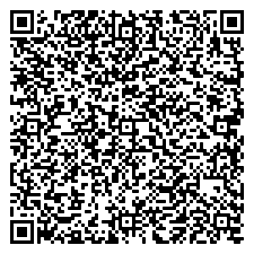
This PowerPoint is used as a template to create inserts for the Type A signage used for offices, classrooms and any personnel assigned space in SAISD. You can print to regular paper or card stock no thicker than 1/32 inches (12 pt. or 110 lb.). You can use colored paper or colored fonts to make the insert pop. Keep the information limited to three lines to avoid having to shrink the text size too much. DO NOT resize the cut-out area, it has been sized to specifically fit the insert frame (1 1/4 inches tall by 6 inches wide) of the signage.
Besides having the persons name, title and department you can also add a virtual business card or vCard using a QR Code. There are several websites that you can use to create a vCard QR Code. Just search the internet for: Free vCard QR Code Generator
Or click the link for a google search. A QR (Quick Response) Code is a matrix barcode that can be read by most cell phones using the camera function. The QR Code works as a quick link to the information you generated when making the QR Code. For example, links to websites, phone numbers, emails, virtual business card, cell phone contact card, typed text, stored documents (like PDFs) and so much more.
Make your office signage smart and you will always be in touch with the world.
Example:
Marcos I. Castillo
Senior Coordinator – Facilities Planning
Construction & Development Services
vCard

Slide 2
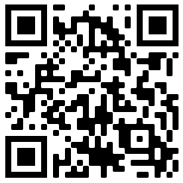
INSTRUCTIONS:
Print this page to have temporary card inserts when no one is assigned to the office space.
When printing from PowerPoint the print size gets automatically adjusted and the card template may not fit correctly.
Recommend printing to Adobe Acrobat or export the PowerPoint to a PDF file first, then print.
When printing DO NOT choose “Fit” or “Scale to Fit Paper” choose “Actual Size” or the print may shrink and may not fit the frame correctly.
John Doe
Future SAISD Employee
Fun & Games Department
To Get Template
John Doe
Future SAISD Employee
Fun & Games Department
To Get Template
John Doe
Future SAISD Employee
Fun & Games Department
To Get Template
John Doe
Future SAISD Employee
Fun & Games Department
To Get Template
John Doe
Future SAISD Employee
Fun & Games Department
To Get Template
John Doe
Future SAISD Employee
Fun & Games Department
To Get Template
John Doe
Future SAISD Employee
Fun & Games Department
To Get Template
John Doe
Future SAISD Employee
Fun & Games Department
To Get Template
John Doe
Future SAISD Employee
Fun & Games Department
To Get Template
John Doe
Future SAISD Employee
Fun & Games Department
To Get Template

Slide 3
INSTRUCTIONS:
Print this page to have card inserts.
When printing from PowerPoint the print size gets automatically adjusted and the card template may not fit correctly.
Recommend printing to Adobe Acrobat or export the PowerPoint to a PDF file first, then print.
When printing DO NOT choose “Fit” or “Scale to Fit Paper” choose “Actual Size” or the print may shrink and may not fit the frame correctly.
Type Name
Type Title
Type Department
Type Name
Type Title
Type Department
Type Name
Type Title
Type Department
Type Name
Type Title
Type Department
Type Name
Type Title
Type Department
Type Name
Type Title
Type Department
Type Name
Type Title
Type Department
Type Name
Type Title
Type Department
Type Name
Type Title
Type Department
Type Name
Type Title
Type Department

